Slide 1
Webinar Introduction to the “new” NIEM Open Project 22 May 2025
Stephen Sullivan

Slide 2
Webinar Agenda
1:00 Welcome and relevance - Maria Cardiellos (Executive Director, IJIS)
1:10 Introduction to the new NIEMOpen – Katherine Escobar (PGB Chair)
1:20 The New NIEM
CMF/CMF Tool ( includes demo) – Dr. Scott Renner (NTAC Co-Chair)
API 2.0 – Dr. Scott Renner (NTAC Co-Chair)
NDR 6.0 and toolkit + future updates – Dr. Scott Renner (NTAC Co-Chair)
1:50 Future Architecture, role of Ontologies, and AI - Brad Bolliger (NTAC Co-Chair)
2:00 The future of NIEMOpen with OASIS – Jim Cabral (Acting Director OASIS)
2:10 NIEM on the ground – Tammi Blackstone, JD (Iowa Integrated Justice Coordinator), Jim Pingel (Mission Critical Partners)
2:20 New dimensions for NIEMOpen in ontologies – Paul Wormeli, Carolyn Staats (Director of Innovation, Sonoma County), Jodi Leveque (Assistant CEO, Sonoma County Courts)
2:30 The future, plans and resources – Katherine Escobar (PGB Chair)
2:35 Open Discussion/Q&A (Katherine Escobar, Maria Cardiellos, NBAC and NTAC Co-chairs)
3:00 Close

Slide 3

Introduction to the new NIEMOpen
As NIEM celebrates its 20th anniversary its worth spending a little time reflecting on how far we’ve come:
Critical Infrastructure Protection in the Information Age
DHS accepts lead agency stewardship
Critical Decision Point
NIEMOpen
2005
2018
2025
Information Sharing
Oct. 2001
2009
2021
DOJ and DHS establish NIEM from GJXDM
DoD accepts lead agency stewardship
NDR v6.0
Model v6.0
API 2.0
MEP Tool
LMS
Key Milestones
OASIS Standard (OS)

Slide 4
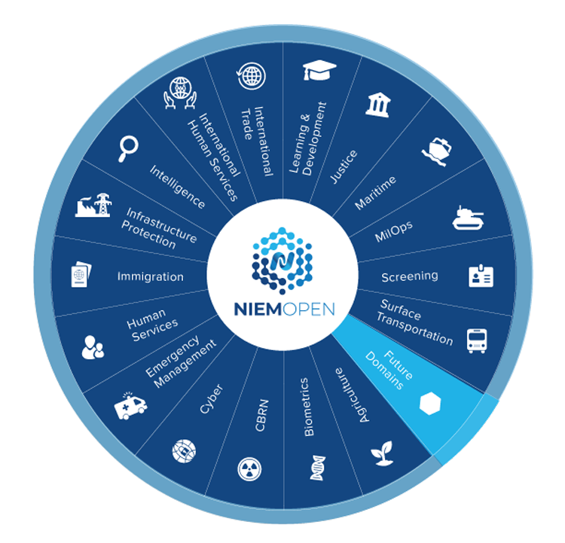
DOMAINS
17 Domains Plus Core
3 Domains in the Offing
Forensics
Analytical Laboratories
Identity Management
Other Interested Parties
DISA
NATO

Slide 5
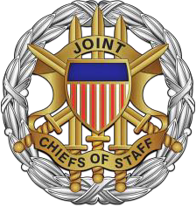



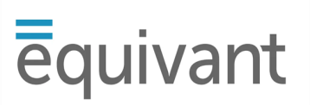














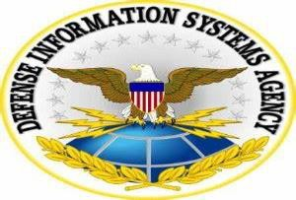








NIEMOpen Current Sponsors
11 Sponsors, 3 Premier
Sponsors
JS J6
DHS S&T
CJIS (FBI)
GTRI
Equivant
NAJIS
BJS
IJIS
NIJ
APN
ODGA (Virginia)
Premier
Premier
Premier
All Purpose Networks, Inc.
Sponsors in the Offing
DHS
OBIM
Office of Standards
Department of National Defense

Slide 6




What can an Open Project do?
Utilize the same tools and infrastructure to develop open source and standards.
Leverage a wide network of experts and stakeholders to inform strategic decisions.
Iterate quickly while taking advantage of thorough, best-practices process.
Attract a bigger community of contributors with clear, open, transparent governance.

Slide 7
What you get (and don’t get) with Open Projects
What OASIS BRINGS to the table
High cost of a Foundation Stakeholder governance
Legal headaches, IPR obstacles Industry-vetted IP licenses, support
Fractured development efforts Unified community
Ignored by government procurement International recognition
Opaque rules and processes Transparent tools, support, best practices

Slide 8
Why OASIS?
NIEM Open Project recognized as accredited standard
Improves International adoption
Preference to accredited standards
Increased scalability and keeps pace with speed of innovations in data technologies and standardization to accelerate adoption and public-private exchange/interoperability
Sustainable
Aligns with Government Policy/Process/Procedure
Open Standard removes barriers – industry hesitation to participate, conflict of interest concern

Slide 9
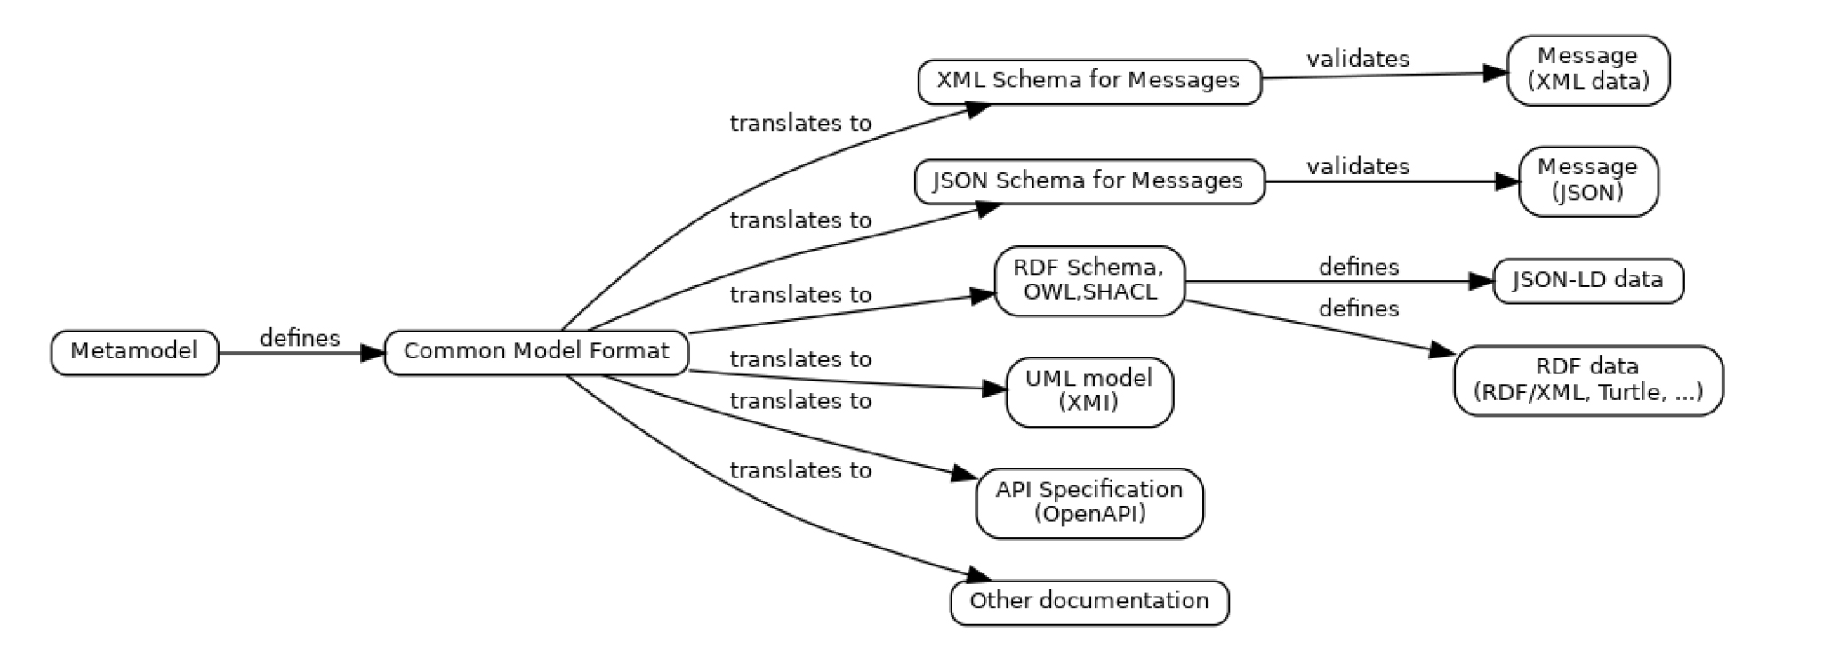
NIEM in the 21st century
Common Model Format (CMF)
NIEM has always used XML Schema as its data modeling language
Model semantics formally defined via mappings to Resource Description Framework (RDF)
Mappings defined in the Naming and Design Rules
Convenient for designers and developers implementing XML-based data exchange
NIEM now supports developers who aren’t using XML
XML Schema is not convenient for them
For NIEM 6, we created the NIEM metamodel and Common Model Format
Metamodel: A conceptual data model for the things we want to know about data models
CMF: A NIEM-based implementation of the metamodel… Just like any IEPD

Slide 10

Leaning forward into the future
Official Standard
New Architecture
New Model
New Design Rules
New Tools & APIs
New Training/Learning Management System
Embracing New Technologies
AI
Knowledge Graphs
Ontologies
Support for Other Standards
Outreach to Industry and International Partners

Slide 11
Webinar NIEMOpen Future 22 May 2025
Stephen Sullivan

Slide 12

The NIEMOPEN Future
Why Choose NIEMOpen
Recognized Standard
Flexible & Adaptable Architecture
Robust AI Support
Host for Emerging Technologies
World Class Accredited Training
Cutting Edge Tools
International Footprint
Industry and Government Choice
Expanding Community of Interest
Sustainable Infrastructure & Growth

Slide 13
ROI of Open Standard Investment
Direct Returns: Increased interoperability, reduced costs, vendor diversity.
Indirect Returns: Spurs innovation, enhances security, accelerates compliance.
Example: NIST & FIPS investment led to globally adopted cryptographic standards.
Notes:
This chart illustrates different categories of ROI — direct cost savings, innovation gains, and national security outcomes.

Slide 14
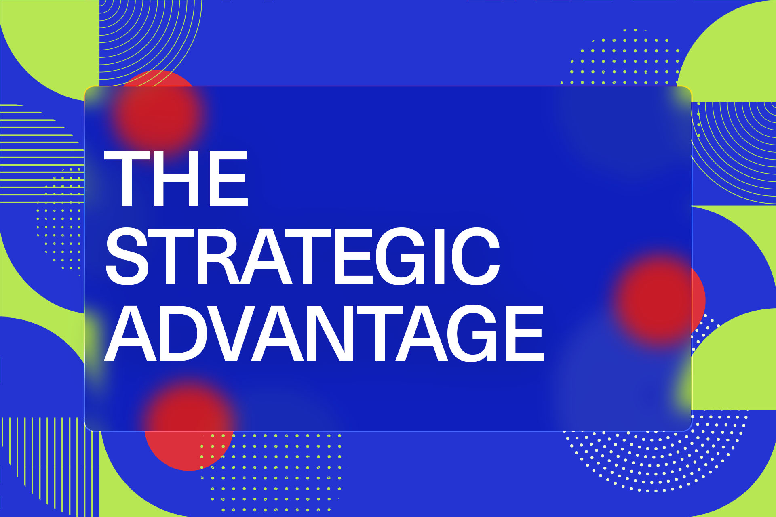
Conclusion
Investing in NIEMOpen isn’t a cost — it’s a strategic advantage.
Now is the time for Federal, State, Local and Industry leadership.
Let’s shape the future, not just comply with it.
Sponsor NIEMOpen
Notes:
Final reminder: leadership in open standards is essential for digital sovereignty and economic competitiveness.

Slide 15





Resources/CONTACT US
Git Repos
github.com/NIEM/NIEM.github.io
NIEMOpen: github.com/niemopen
NTAC TSC (admin): github.com/niemopen/ntac-admin
NBAC TSC (admin): …/nbac-admin
NMO TSC (admin): …/nmo-admin
oasis-open.org
niempen.org
niem.gov/
Groups & Mailing Lists
NIEMOpen: lists.oasis-open-projects.org/g/niemopen
NTAC TSC: .../niemopen-ntactsc
NBAC TSC: .../niemopen-nbactsc
NMO TSC: .../niemopen-nmotsc
Latest Model Specification v6.0 PS02
GitHub - niemopen/niem-model: The NIEM reference data model
On the Website, select an option for access:
Notes:
Beth Smalley

